Slide 1

COMPARING SEVERAL METHODS OF REINFORCEMENT LEARNING IN SOLVING A COMPLEX MAZE
Li Meng S2651513
Mega Bagus Herlambang P279285
Yuying Chen S3421902
Zhuoyun Kan S3346935

Slide 2
What is reinforcement learning?
“In reinforcement learning, the learner is a decision-making agent that takes actions in an environment and receives reward (or penalty) for its actions in trying to solve a problem.” (Alpaydin, 2014, p. 517)

Slide 3
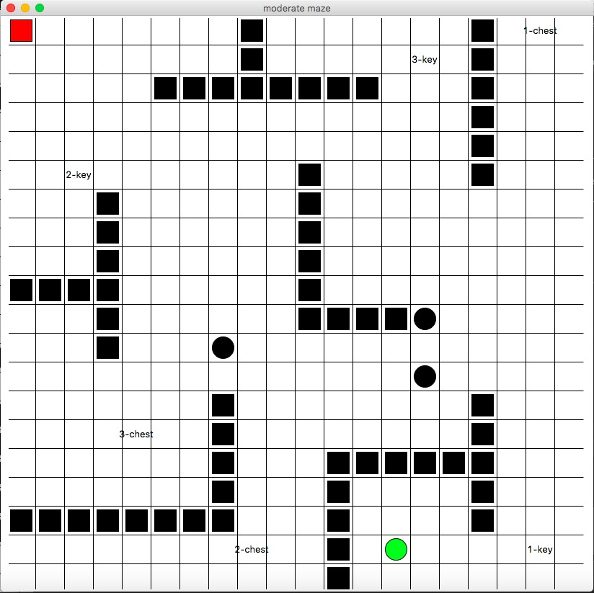
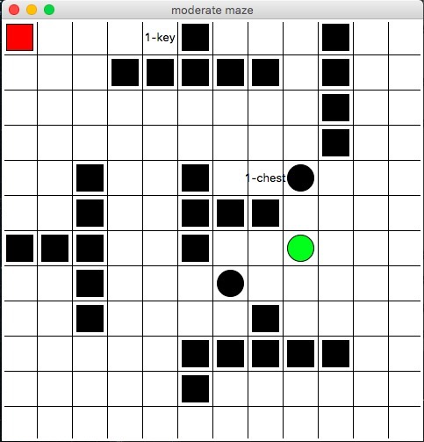
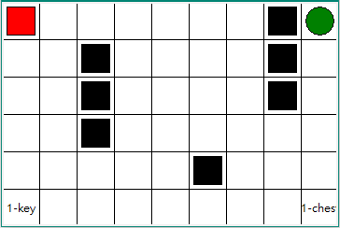
The maze
To compare performances with different algorithms, different kinds of mazes are designed
Elements in the maze:
Walls
Pits
Pairwise keys -> chests
Exit

Slide 4
Goal & rules
Get maximal rewards in shortest path
Find the key -> open the chest -> exit ☺
Can not go through the fixed walls
Have punishment when stepping into the pits ☹

Slide 5
algorithms
1. Basic algorithms:
2. Algorithms with lambda:
Q-learning
Sarsa
Q-lambda
Sarsa-lambda
QV-lambda
Indicators
Maximal rewards to obtian
Steps to solve the maze

Slide 6
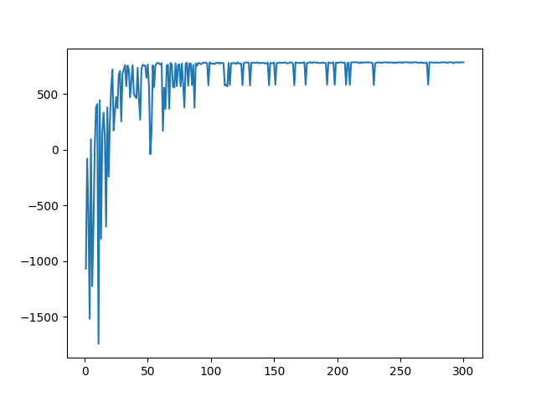
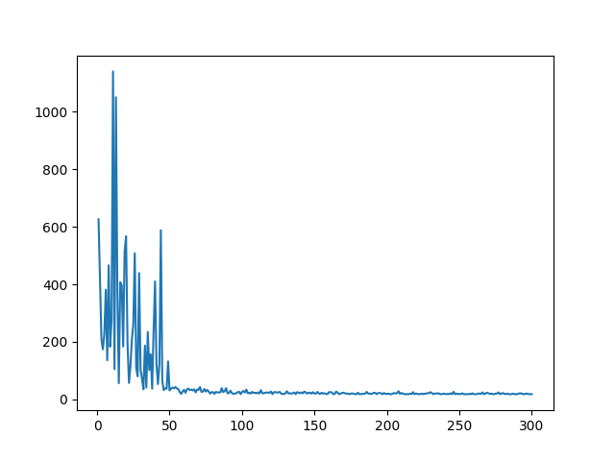
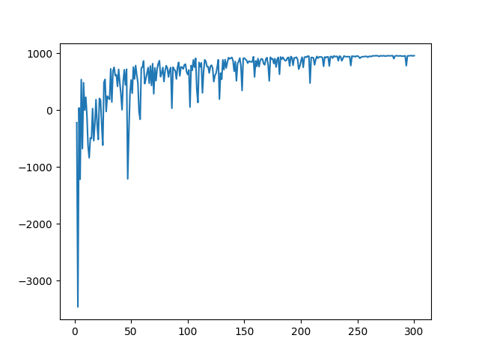
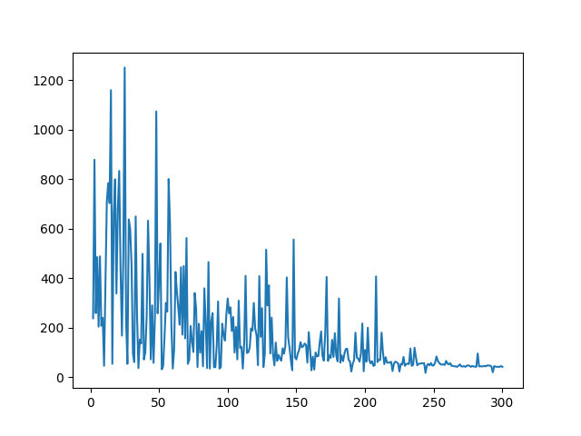
Q-LEARNING & Sarsa
Q-learning
Sarsa
rewards
steps
rewards
steps
Q-learning gets lower rewards with fewer steps.
It is brave to step into pits.
Sarsa gets higher rewards with more steps.
It scares to be punished by stepping into pits.

Slide 7
Algorithms With LAMBDA
1. Lambda = 0
2. Lambda = 0.5
3. Lambda = 0.8

Slide 8
To get optimal convergence
Dynamic greedy:
The greedy increases depending on time in training phase
Rewards and punishments of different elements
key = 0, chest = 500, exit = 500
When two rewards compete :
new coefficient: x-p/p(1-p)
……….

Slide 9
conclusion
...life is hard ☺

